Slide 1
SMART TOILETS
By Ahmed, Susheel, prudhvi and Hussain.

Slide 2

Problem
Wastage of electricity when the lights in the toilets are left switched on after use.
Unnecessary consumption of electricity during day time when there is reasonable amount of natural light present in the room.
Lingering foul smell after the use of the toilets.

Slide 3
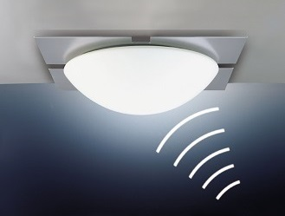
Project Summary
Motion sensor senses if there is motion in the room or not.
LDR sensor will detect the presence of natural light in the room.
Sound sensor will detect the ‘splash’ sound from the flush.
The data from all of these sensor will be processed in Arduino.

Slide 4
Background
A system with Arduino, PIR motion sensor, Photosensitive LDR sensor and a sound sensor will be set up.
This system will detect the motion in the toilet and turn the lights on only if there is no natural light present in the room.
It will detect the ‘splash’ sound from the flush and spray air freshener when the flush goes on.

Slide 5
Research Questions
Where should the motion sensor be placed in order to detect the motion of the object in the room?
Where should the LDR sensor and sound sensor be placed in order to detect the light and sound respectively?
How will objects such as pets entering the room affect the motion sensor?

Slide 6
Sensing, Thinking and Acting
Sensing : Gathering data from all the sensors.
Thinking : Analyzing the collected data.
Acting : All the data from the sensors will be evaluated by the Arduino Uno and processed to achieve the desired outcome.

Slide 7
IOT Project – GROUP 8
By Ahmed, Hussain, Susheel and Prudhvi

